Slide 1


Unit 2: Culture spot 2 The land of the free
U ovoj ćemo lekciji:
uspoređivati past simple i present simple
govoriti o
„američkom snu”
manjinskim zajednicama u SAD-u
socijalnim problemima
ljudskim pravima
ljudima koji su promijenili svijet

Slide 2

Is Croatia a multi-cultural country? How many minority groups are there in Croatia?
Reading 
❶ The USA is a multi-ethnic country. People from all over the world come to the USA to make a life there. Read the stories and find out the meaning of the words in bold.

Slide 3
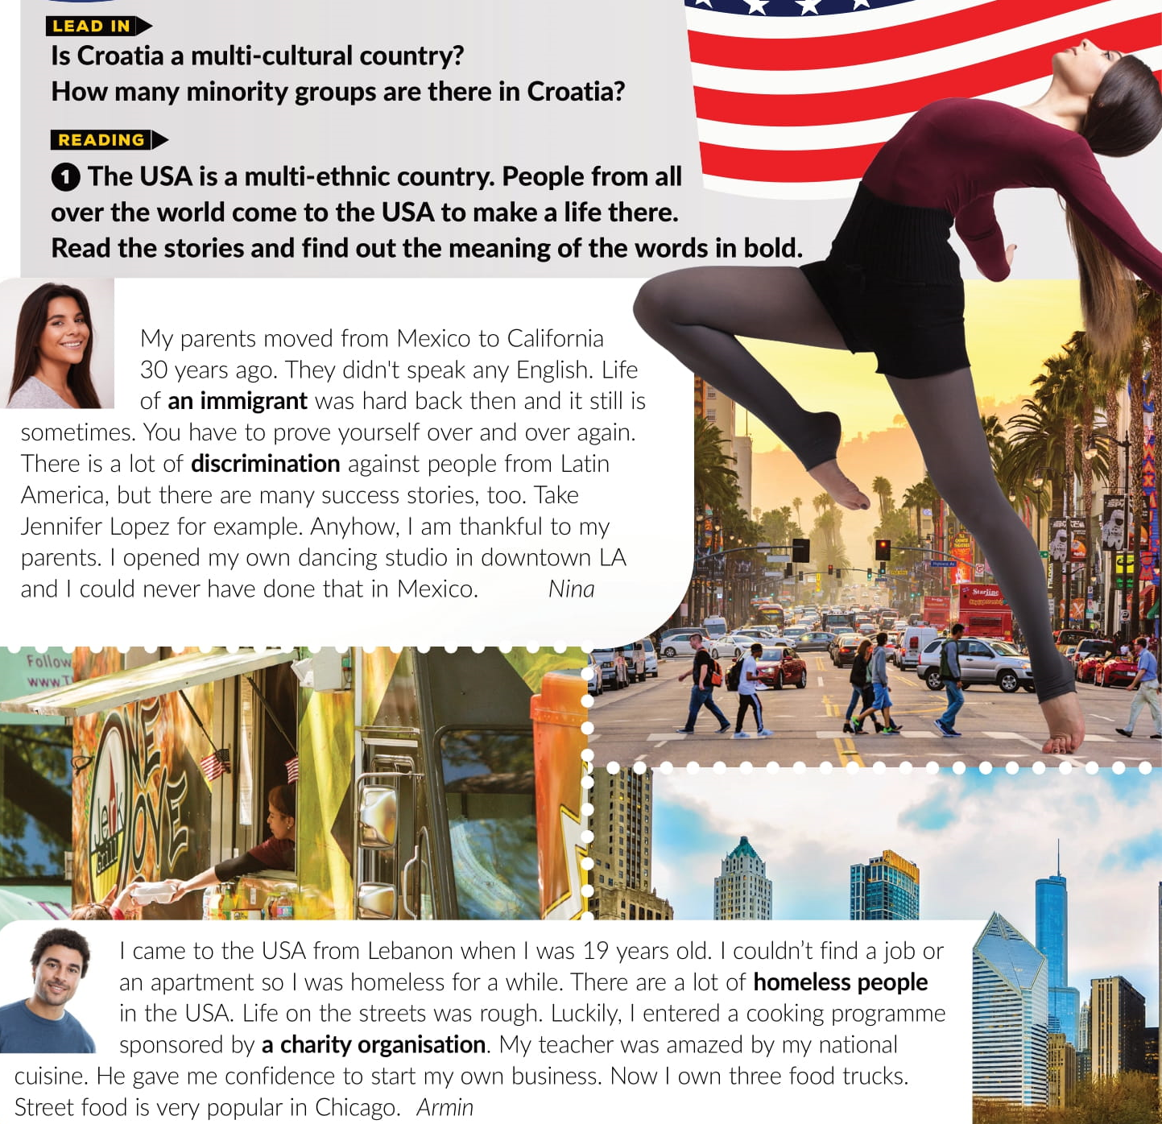

Slide 4
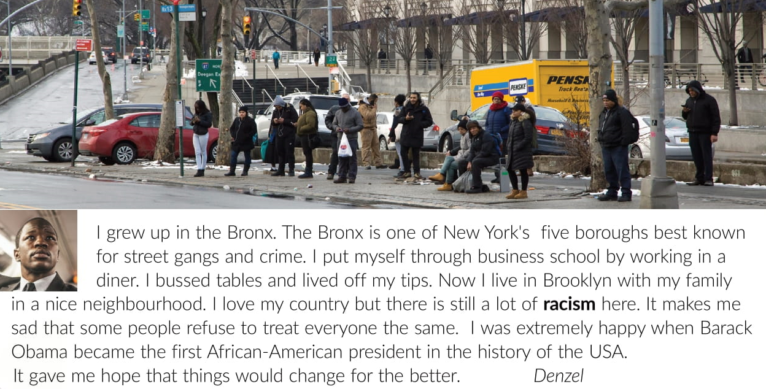

Slide 5
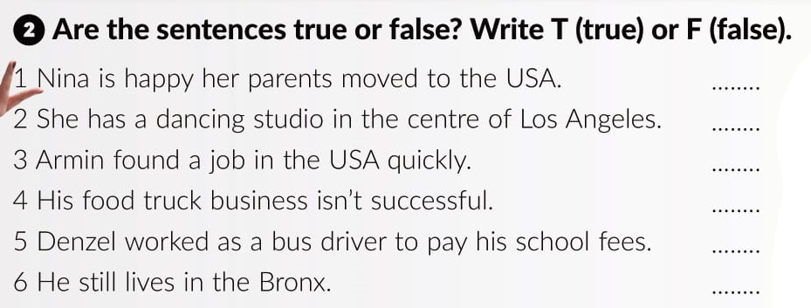
T
T
T
F
F
F

Slide 6
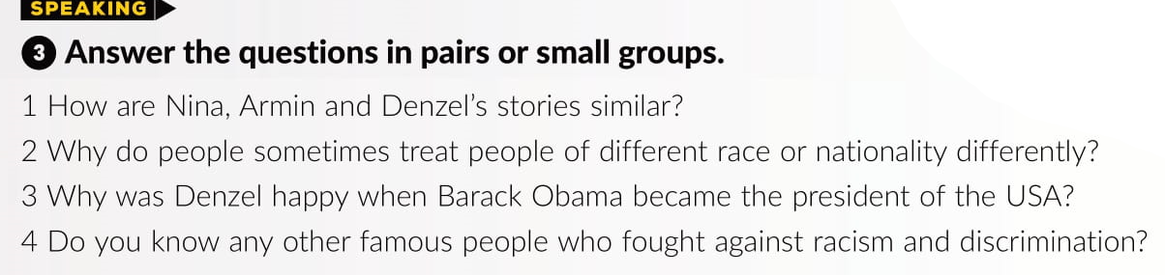

Slide 7
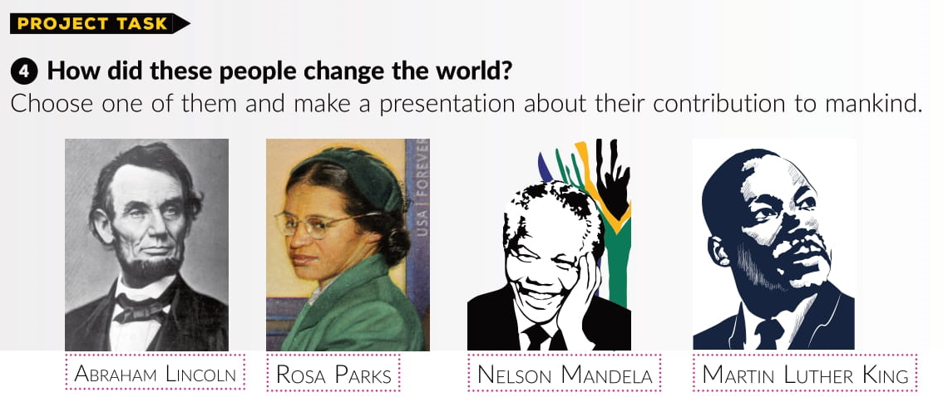

Slide 8
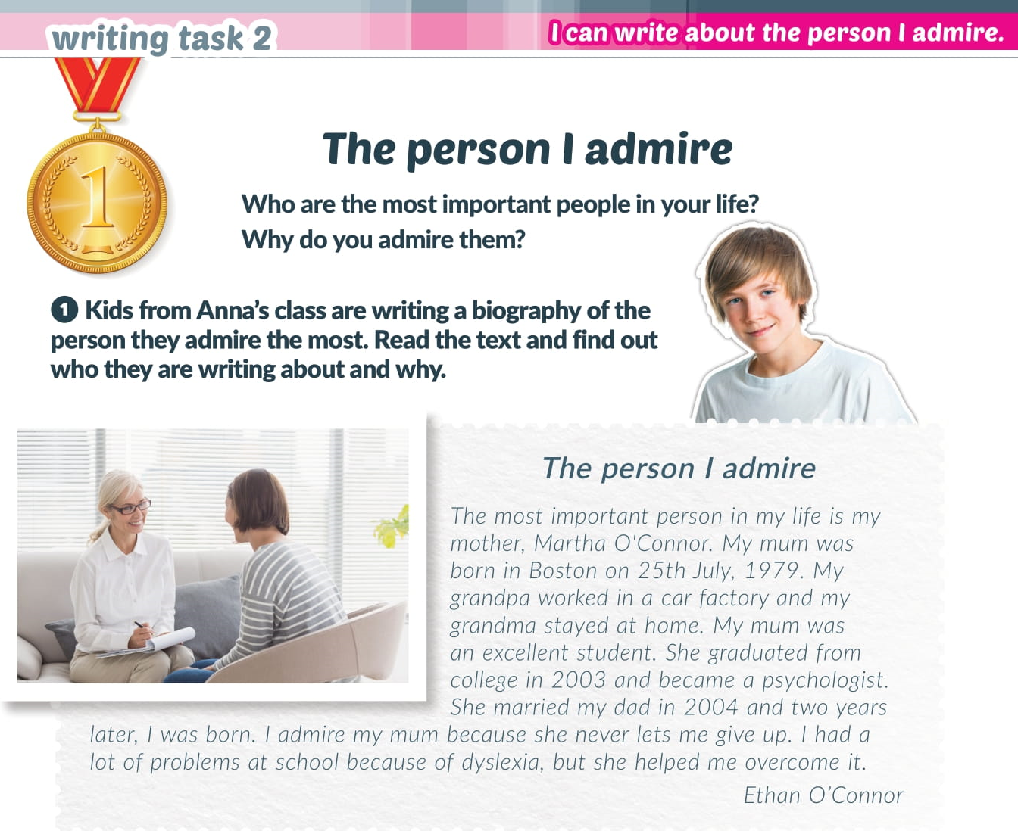

Slide 9
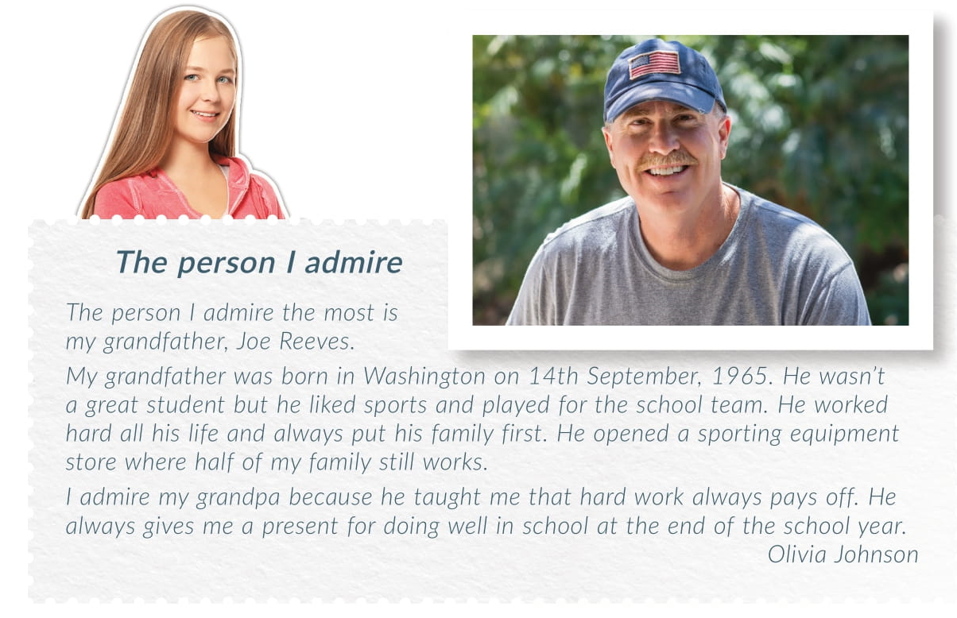

Slide 10


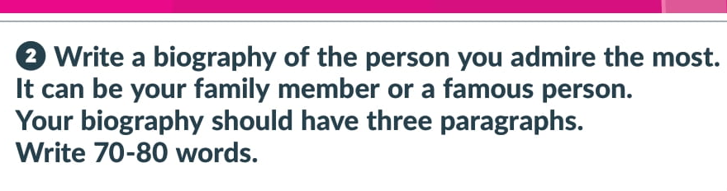
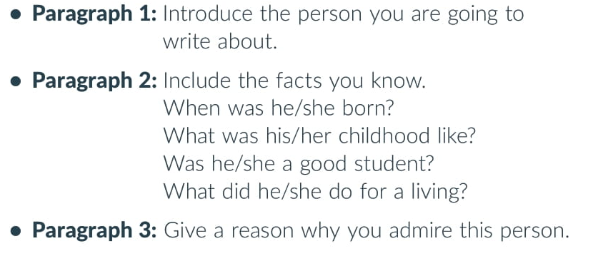

Slide 11

Otvori sljedeću poveznicu, te odaberi PLAY AND LEARN!
Culture spot 2 The land of the free | Way to go 4 (e-sfera.hr)

